Slide 1
CMAC 3990.200
Systems Administration and Operations
Fall 2025 – Week 1.1 – August 25th, 2025
Introduction and overview, Review
A little bit of new

Slide 2

Objectives
Intro & Info
Syllabus
Textbook Information
Class Expectations
Lab Hours
Tentative Class Schedule
History of computer networking
Requests For Comments (RFC’s)
Terminology
Server Hardware Considerations
Network Configurations
Internet Protocol Addressing
Domain Names
DNS
HA

Slide 3

Weekly Info
“Happiness is not something ready made. It comes from your own actions.” – Dalai Lama
Attendance
Good of the Class
  Anything interesting from the summer?
Preferred method of communication is E-Mail.
“If you don’t have influence, you will never be able to lead others”
- John C. Maxwell

Slide 4

Recap and Review
Review of topics from last class
Corrections, updates, etc.
Review of previous assignments
Questions from previous classes
Assignments due?
Etc…

Slide 5
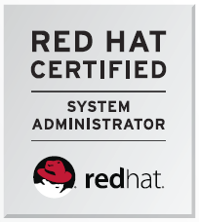
About Me
20+ Years professional systems administration
  Small business, university, enterprise
10+ Years teaching in higher-education
  Create new classes, mentoring, committees…
Linux, Unix, Windows IT Administration
  Red Hat Certified System Administrator
  AWS Certifications
    Cloud Practitioner, Sysops Admin, Solutions Architect
  CentOS
  Raspbian
Networking
  IPv6
Virtualization & Cloud
Website - http://jpatalon.cs.edinboro.edu
  Class Files
  Office Hours
  Contact Info
  Assignments
  Class Schedule
D2L
  Grades
  Assignment submissions
  Class Files
  Office Hours
  Contact Info
  Assignments
  Class Schedule
jpatalon.ultrastuff.net

Slide 6
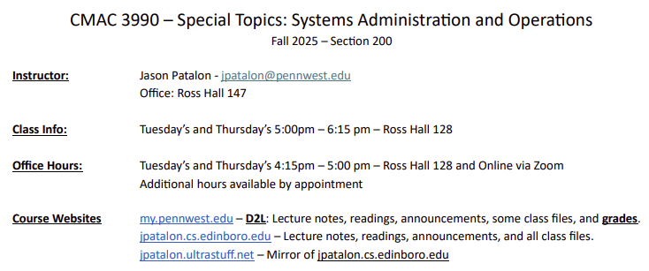

Syllabus
CMAC 3990.200 202610 Syllabus
Available at
  http://jpatalon.cs.edinboro.edu
  http://jpatalon.ultrastuff.net
  D2L
    Redundancy!
About the class
  Virtual Machines
  Read, discuss, walkthrough, implement, check, test
  CentOS 8 Linux Operating System? 9? 10?
    Fedora → CentOS → Red Hat Enterprise Linux
  Assignments can include written documentation
  and technical configuration implementations

Slide 7
Attendance
Regular and punctual attendance is expected. This course will follow attendance guidelines set forth in the Class Attendance Policy and Procedure section of the university catalog. Any in-class exercises must be done in class and are not available for make-up.
University Class Attendance Policy
ATTENDANCE POINT/GRADE SUMMARY
3 Points per class – 28 class periods – 84 points total (5.3% of total grade)

Slide 8
Class Expectations
Regular and punctual attendance is expected.
Disruptive behaviors, including but not limited to excessive talking, arriving late, sleeping, or using unauthorized electronic devices during class, are not permitted.
There is no tolerance for cheating or plagiarism.
Turn in all homework on time. Late homework assignment submissions are not accepted.
Assignments are due by the end of the day of the specified due date.
All exams must be taken during the scheduled class exam time, unless prior approval is given from the instructor.
Inform the instructor of any special needs or arrangements, including university sports or disability requirements, at the beginning of the semester!

Slide 9
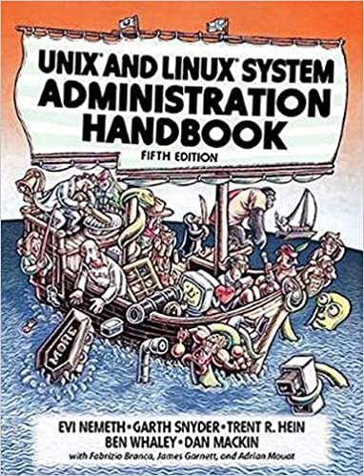
Book Info
Required:
  UNIX and Linux System Administration Handbook – 5th Edition
    Nemeth, et el. – Addison-Wesley 2017
    ISBN: 978-0134277554
    https://www.amazon.com/UNIX-Linux-System-Administration-Handbook-ebook/dp/B075MK6LZ7
Recommended:
  Linux Administration: A Beginner’s Guide – 7th Edition
    Wale Soyinka – McGraw Hill 2015
    ISBN: 978-0071845364
    https://www.amazon.com/Linux-Administration-Beginners-Guide-Seventh/dp/0071845364
  The Practice of System and Network Administration – 2nd Edition
    Limoncelli, Hogan, Chalup – Addison-Wesley 2007
    ISBN: 978-0321492661
    https://www.amazon.com/Practice-System-Network-Administration-Second/dp/0321492668

Slide 10
Book Info
Recommended :
  AWS Cloud Account
    Free AWS Educate account, very inexpensive personal accounts with free trials…
Recommended:
  1+ GB Cloud Storage
    Off-Campus, off-site, third party
    Preferably not AWS
    GitHub, DropBox, MS OneDrive, Google, etc.

Slide 11
Lab Hours
Library Hours
Ross Hall Labs
  Ross 137 – Math & CS Computer Lab
    For CS majors, 24 hour access with passcode
Contact IT Help Desk for additional
computer lab locations and availability
  (814) 732-2111
Optimally – you should not need a lab!
  My goal is to make everything available online, with remote
  connectivity to everything through various tunnels & VPN’s

Slide 12
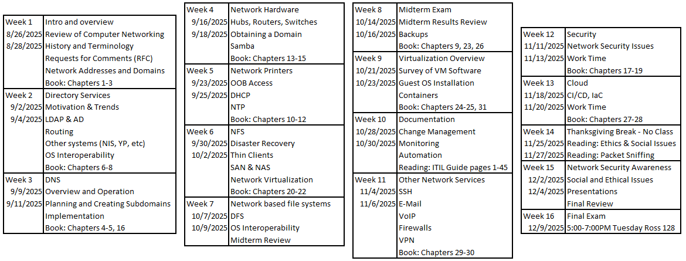
Tentative Class Schedule

Slide 13
Class Presentations
Group project and presentations?!
1-2 People per group???
Presentations approx. 7-10 minutes each
Include 4-5 page paper discussing topic, history, and related technologies
200 points total (20% of final grade)
Presentations on 12/02/2025 and 12/04/2025
Optional other topics with instructor approval
E-Mail Professor with ideas/questions
Project proposal required!
More info about presentations to come…
Presentation Topic Examples
DNS / DHCP | SELinux
SAN | DFS
Virtual Machines | ACL's
Hyper-converged | Pen Test
Clustering | NTP / PTP
Containers | IPv4 / IPv6
NAS | Disaster Recovery
AWS / Cloud | Other…
Questions?

Slide 14
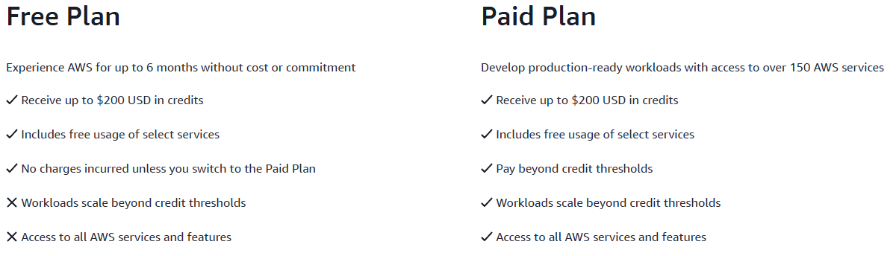

AWS Accounts
Some things are free, some things cost money
Turn off things when not in use!
We will walk through a few
different methods of things!
Key Items:
  Automation
  Version Control
  Repeatability
  Infrastructure as Code

Slide 15

The Internet and the World Wide Web
1961 – Planning begins for internet communications
  Packet-switching technology first discussed
1969 – Origin of the Internet
  ARPANET carries its first packets
1982 – TCP/IP protocol suite formalized
  SMTP/DNS shortly afterwards
1985 – First .COM domain name registered
1988 – OSI Model Introduced
1989-91 – WWW Introduced
1995 – Commercialization and privatization
  New internet architecture developed
  Very high-speed Backbone Network Service

Slide 16
The Internet and the World Wide Web
The Internet – A worldwide network of networks
Protocols govern how devices communicate
Uses TCP/IP – “The Language of the Internet”
  Transmission Control Protocol/Internet Protocol
  IP Addresses provide unique identification on a network
World Wide Web - An open information space where documents and other web resources can be accessed via the Internet.
The Internet is not centrally controlled

Slide 17
The Internet and the World Wide Web
Internet Backbones:
A principal data route between large, strategically interconnected networks and core routers on the Internet.
Requires high-speed bandwidth connections and high-performance servers/routers.
Primarily owned by commercial, educational, government and military entities.
UUNET, AT&T, GTE, Sprint/Nextel
Connections like T1, T3, OC1, OC3 or OC48.

Slide 18
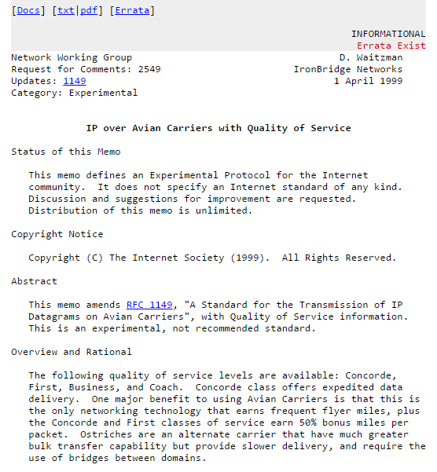
Request for Comments (RFC)
A document from the Internet Engineering Task Force (IETF) and the Internet Society (ISOC)
Describes methods, behaviors, research, or innovations applicable to the working of the Internet and Internet-connect systems
Some are adopted and published as Internet Standards
The official documents of Internet specifications, communication
protocols, procedures, and events
Originated with ARPANET, to help record and standardize unofficial
notes on development
Originally intended to encourage discussion and prompt comments

Slide 19
Request for Comments (RFC)
RFC’s are assigned a serial number, identifying the specific RFC
If necessary, RFC’s may supersede others, causing the old RFC’s to be deprecated or obsoleted by the new updated RFC.
This order of RFC’s compose a continuous historical record of the
evolution of Internet standards and practices
The RFC process is documented in RFC 2026

Slide 20
Request for Comments (RFC)
RFC’s contain three sub-series:
  Best Current Practice (BCP) – Mandatory but not on a standards track
  For Your Information (FYI) – Informational only; obsoleted in 2011 by RFC 6360
  Standard (STD) – Internet standard, split in to two maturity levels
    Proposed, Internet
RFC’s are generated through one of four streams
  Internet Engineering Task Force (IETF)
    Only stream to create BCP’s and RFC’s on the standards track
  Internet Research Task Force (IRTF)
  Internet Architecture Board (IAB)
  Independent Submission
    Intended to contain relevant information or experiments for
    the Internet that is not in conflict with other work

Slide 21
Request for Comments (RFC)
RFC’s can have one of the following status:
  Standards Track
    Proposed, and Internet Standard documents
    Older Draft standards may still exist
  Informational
  Experimental
  Best Current Practice
  Historic
  Unknown
  All RFC information is standardized in … RFC’s!

Slide 22

Servers
A server is both a running instance of some software that is capable of accepting requests from clients, and the computer hardware that executes such software.
Provide underlying services for email, databases, websites, cloud storage, and more.
Server operating systems
  Windows Server 2016
  Red Hat Enterprise Linux 7
Extra redundancy
Higher Power Components
Combination of services
Separation of duties

Slide 23
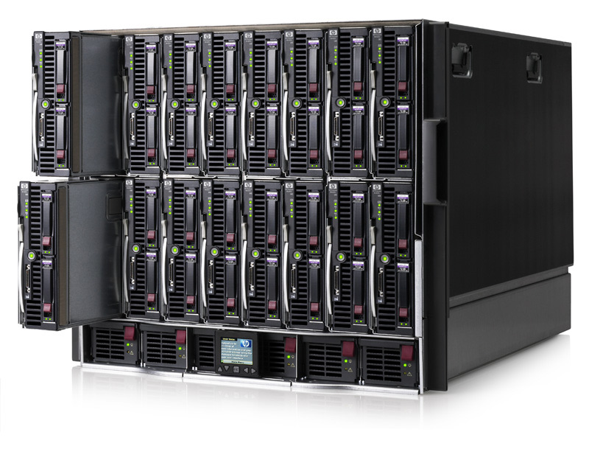
Types of Server Hardware
Towers
  Shaped similar to a desktop tower
  Increased space within server for extra devices
Rackmount Servers
  Long, thin, boxes
    Similar shape to a pizza box
  Allow increased rack space usage
Blades
  Share common blade enclosure
    Many contain converged network/storage devices
  Best option for rack space usage
Hyperconverged
  Compute and storage distributed across
  multiple nodes (blades).

Slide 24
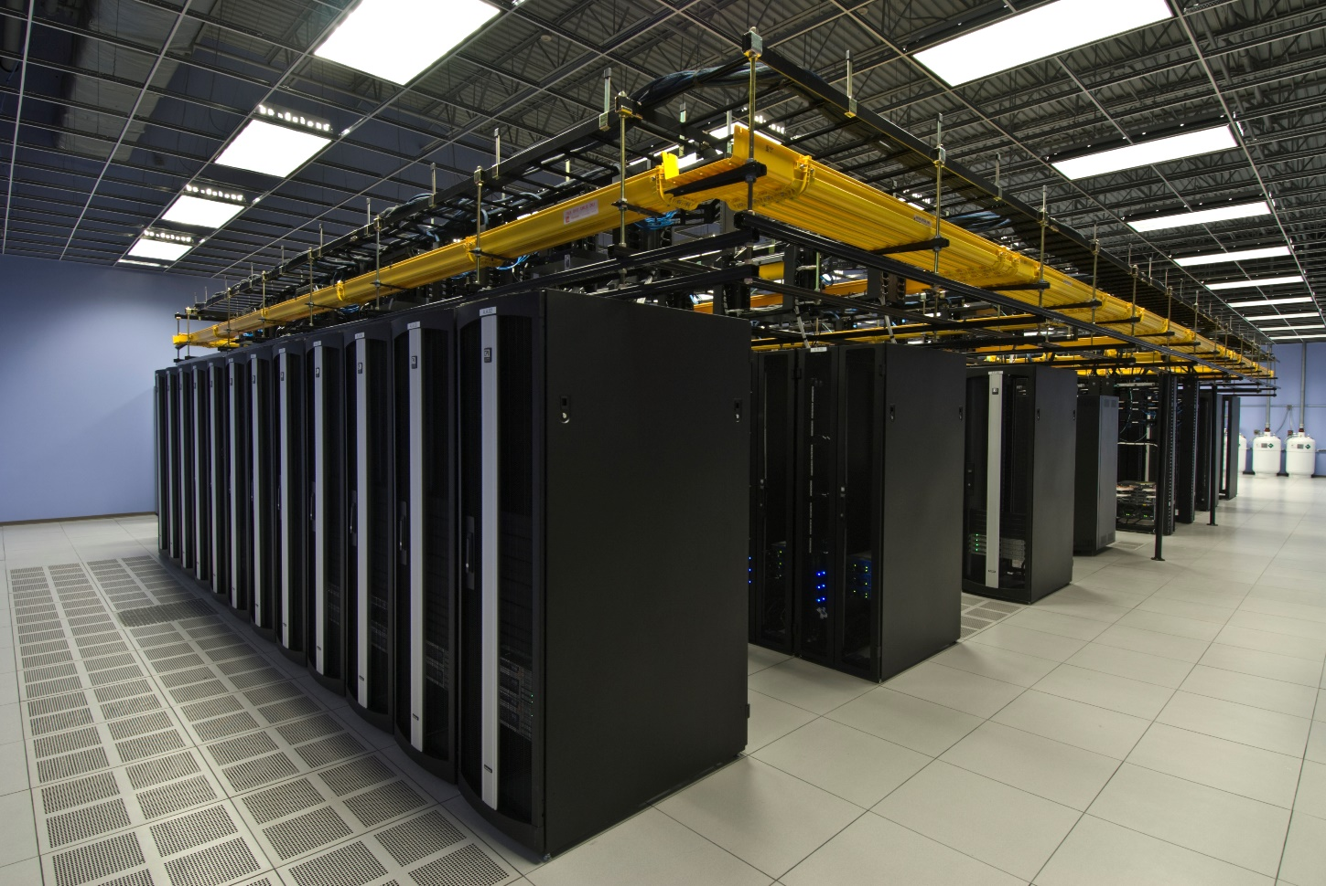
Server Environment
Multiple servers
Rackmount environment
Secure access
Heating/Cooling/Humidity Controls
  Hot/Cold Aisle
Raised floor design
Redundant connections
Cabling designs
Fire and disaster
Datacenter location

Slide 25
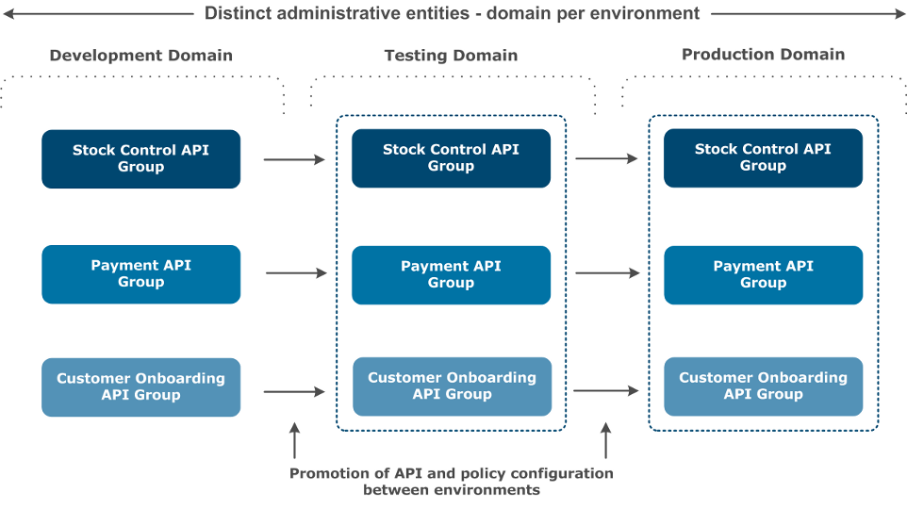
Development Environments
Multiple environments such as dev-a, dev-b, user-test, app-test, performance, acceptance, production
  System Development Life Cycle (SDLC) Environments
Multiple machines per environment
Various levels of access security
Separation between environments
Duplication of production resources
Lower environments may differ
substantially from production
Possibility of multiple testing or
development environments
Not pictured are staging, performance
testing, or quality assurance tiers

Slide 26
Server Considerations
CPU
  Single or Multiple CPU’s
  Number of cores
  Features
Redundancy
  RAID ability
  Multiple connections
Disk
  Capacity
  Onboard Direct Attached Storage (DAS)
  Storage Area Network (SAN)
  Network Accessible Storage (NAS)
Memory
  Size
  Speed
  Type
Connections
  Network Connections (eth)
  Storage Connections (fc)
  Power
  Out Of Band (OOB)
Licensing
  Restrictions on CPU count
  Virtual vs. Physical server

Slide 27
Server Considerations
Out Of Band Access
  Access to the console interface of the device through a separate, independent network.
Clustering
  Storage clusters provide large and redundant data storage options.
  High availability clusters eliminate single points of failure in specified systems.
  Load balancing clusters separate load among nodes, allowing for growth on the fly.
  High performance compute clusters perform many simultaneous calculations.
Fault Domains
  Related items that can all be affected by the same fault
Bandwidth
  The rate of available or consumed capacity
Appliances
  Specific hardware configuration
  Specific infrastructure connections
  Physical or virtual
Converged Devices
  Provide multiple functions
  Virtualize functions
  Ex: Converged Network Adapter (CNA)
    Fiber Channel (FC) Host Bus Adapter (HBA)
    TCP/IP Ethernet NIC and Fiber Channel Storage (FC)

Slide 28
Server Hardware Strategies
Single server machines can provide one or many services
  Best practice is to separate services onto different servers
Single servers may have many dependents
  A server may provide services to one or thousands of clients
Common server strategies
  All eggs in a single basket – One server performing many functions
  Unique snowflakes – Many uniquely configured servers
  Fractional allocation – Large servers partitioned into many smaller VMs’ or containers
Alternative server strategies
  Grid computing – many machines acting as one unit
  Blade servers – Many separate machines in one chassis
  Cloud computing – Using someone else’s servers
  Software as a Service (SaaS) – Web hosted applications
  Appliances – Purpose built machines providing a specific service

Slide 29
Server Hardware Strategies
All eggs in one basket
  One server may host DNS, DHCP, AD, E-Mail, Web servers, etc.
  Potential single point of failure – how much redundancy is in this single server?
  Not recommended, but may be the only option
    Make sure the server is quality!
    Build in redundancy every way possible (RAID, NICs, etc.)
  OS patching and upgrades become difficult
    Services must be compatible with new software versions
    One service incompatibility may hold back upgrades and cause security issues
  Forklift Upgrades
    Wholesale replacement of a system – remove one machine and replace with another
  Software package dependencies may conflict
    One application requires a newer version of software that another cannot use
  Difficult to schedule downtime

Slide 30
Server Hardware Strategies
Beautiful snowflakes
  Separate machines for each separate service – preferred over a single machine for many services
  Each machine sized according to the necessary resources (RAM, CPU, disk, etc.)
  Fleet of unique machines
    Can be difficult to manage
    Adds administrative overhead
    Different configurations or technologies for each machine
  Asset tracking becomes more important
    Each machine’s applications, configurations, and specifications need to be documented!
    A machine owner or administrator should be added wherever possible – who knows it best?
  Automation becomes key
    Automate patching, backups, data collection so it can be applied to many machines at once
  Reduce variation
    Having a standard hardware vendor and standard configuration helps reduce overhead
    Limit the number of hardware configurations and OS variations

Slide 31
Server Hardware Strategies
Fractional Allocation
  Buy similar or identical hardware in bulk, getting discounts and streamlining configurations
  Fractionalize the hardware in the form of containers or Virtual Machines
  Provides for better use of resources and easier resource adjustments
    Change CPU count, RAM allocation, or disk size from your desk instead of going inside the data center
    Adjust the number of VM’s on a physical host to best utilize the underlying resources
    Stranded capacity – wasted server resources, unusable by other applications or services
  Server Independence – each VM can run a different OS
  Resource Isolation – RAM/CPU/etc. committed to one machine can’t be used by another
    One runaway process won’t affect another service
  Security – One compromised server won’t affect all others
    Separation of duties to different application teams
  Reduced dependency conflicts
    Each system can have its own set of supporting software packages and libraries

Slide 32
Server Hardware Strategies
Fractional Allocation
  VM Clusters can be configured with API calls
    Automation and interfaces can be put in place to allow users to create VM’s
    It is important to determine who can create or make changes to VM configurations
    Limits should be in place to prevent over-allocation of resources
      A rouge developer shouldn’t be able to consume all of a hosts resources!
    Users are easily confused – keep it simple!
  VM Clusters can be expanded on the fly
    VM’s can be migrated between hosts live
    VM hosts can be added to and removed from the cluster without interruption
  Create clusters with spare capacity for maintenance and failures
    Can all your VM guests run if one host fails?
    Have a spare machine, or spare capacity on each machine
    This is often called N+1 allocation

Slide 33
Server Hardware Strategies
Fractional Allocation
  Containerization
    A virtualization technique at the process level, within an individual server
    A group of processes are isolated on a single machine
    Multiple containers may be run on a single machine
    Each container is self-contained, preventing dependency conflicts
    Typically the container OS is stripped down, and necessary software is installed within the container
      Containers will usually share the underlying kernel and management framework of the host OS
    Self-service container creation and administration is also possible
    Re-producibility is key!
      A container may need to be destroyed and re-deployed to take advantage of underlying kernel upgrades
      Create the container in a way that it can be easily reproduced
Pets vs. Cattle
  Disposable servers make it easy to replace and refresh hardware

Slide 34
Server Hardware Strategies
Grid Computing
  Take many similar machines and manage as a single unit
  Scheduling must mix requests to minimize downtime
  Various different algorithms can be used to maximize utilization
    Google has simulators to run test new algorithms before they are put in to production
  All machines typically run under the same OS configuration
  Machines can easily be added, removed, or rebuilt in case of problems
  Computational requirements can dictate quantity and quality of components
    Fewer faster CPU’s, or more less powerful CPU’s
  Easier to manage
    Grid nodes are cattle and can be easily replaced
  Often used for compute intensive tasks
    Weather simulations, stock forecasts, Bitcoin mining, etc.
  Jobs typically run in a batch nature

Slide 35
Server Hardware Strategies
Blade Servers
  Reduce installation overhead by putting many servers in a single chassis
  Chassis can contain redundant cabling and connections, eliminating cables
  Blades typically just slide in and connect to the chassis
    No additional wiring necessary
    Blades can be removed and replaced quickly and easily
  Software can be used to configure much of the blade
    Allocate storage from storage array to blade instead of installing physical disks
  Increased compute capacity in the data center

Slide 36
Server Hardware Strategies
Cloud Computing Services
  Rent capacity from someone else
  Benefit of highly available and redundant systems, without any specific knowledge of system
  Web-based platforms
    Dropbox, Google Drive, etc.
  Computing platforms
    Elastic infrastructure that can be allocated and deleted at will
    On-demand and pay as you go
  Someone else maintaining the hardware, software, and connectivity
    Amazon Web Services
      Datacenters, networks, hardware
      System/Network/Database administrators
      Redundancy!
    Cost of hardware declines, but cost of managing infrastructure has gone up!
  Things as a Service

Slide 37
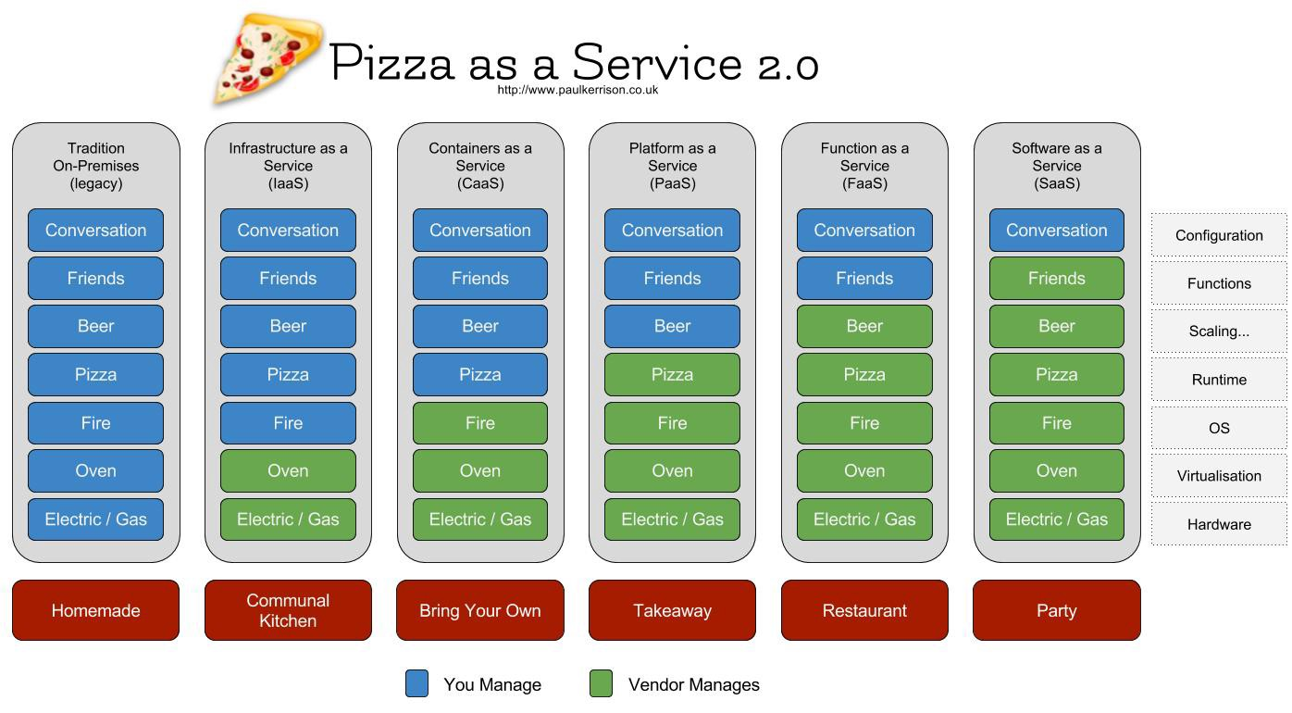

Slide 38
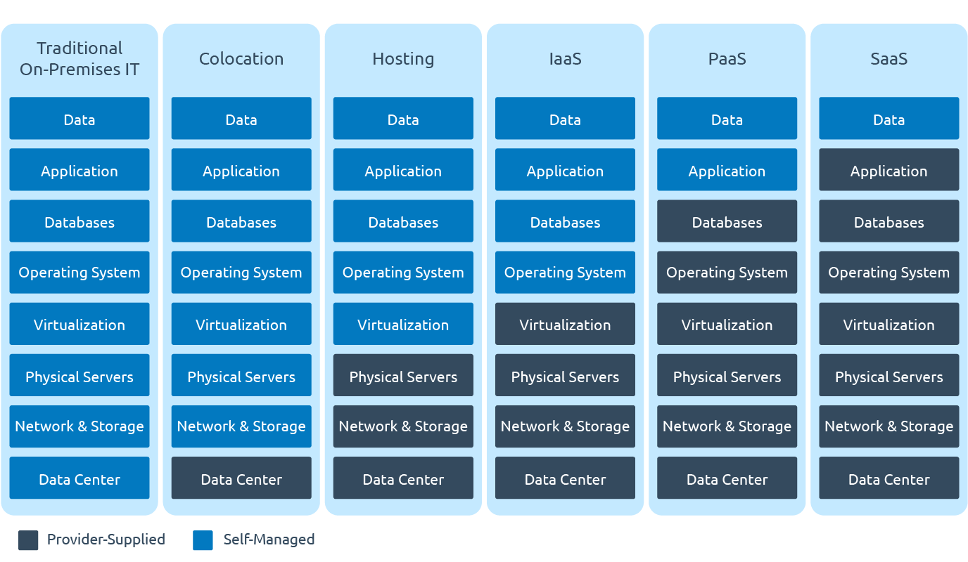

Slide 39
Server Hardware Strategies
Serverless architecture
  Code can run as needed
  Only charged when code is executed
  Flexibility for developers
  Only charged when code is executed, instead of for a full VM
  Focus shifts on integration, coordination, and development
Server appliances
  A device designed to perform a specific task
  May just be commodity hardware with special software
  May just be a custom virtual machine configuration
  A single device designed to perform a single task very well
Hybrid strategies

Slide 40
Server Hardware Features
Enterprise server hardware
  Prioritizes the needs of commercial applications that businesses use
    E-mail, applications, file servers, etc.
    Redundancy
Cluster server hardware
  Prioritizes the needs of clustered or distributed applications
    Hadoop, Cassandra, web server farms, etc.
    Typically stripped down to just the basics
      CPU, RAM, bandwidth, etc.
Higher performance components
  More and faster CPU’s, more RAM, more storage, more I/O capacity
  More physical space to house more components
Rack Mountable

Slide 41
Server Hardware Features
High availability options
  Multiple power supplies
  Multiple network interfaces
  Multiple hard disks
  Redundancy!
Remote Management
  Out of Band (OOB) management
    HP iLO
    Dell DRAC
    IPMI
  KVM
    In band and out of band options
Sensors and hardware monitoring features
Reliability!

Slide 42
Server Hardware Features
Operating systems
  Removed applications
  Only essential software installed
    Less resources utilized
    Improved security
  Server functionality
    Active directory, etc.
  Higher priority of patching
Reliability
  Mean Time Between Failures (MTBF)
Restricted access, controlled location
  No servers outside of the server room!
Hot-Swappable Components
Redundancy!

Slide 43
Server Hardware Features
Remote management
  Console access
  OOB Management
  Remote power cycle
  Remote OS installation on bare metal
  Separate administrative network!
    Prevent unauthorized access to management network!
    Dedicated network connections
Maintenance Contracts
  Who is doing repairs?
  Spare parts
  Experienced vendors

Slide 44
Being a Sysadmin
The keys to being a successful sysadmin is being able to accomplish:
  Set up your environment
    Custom configurations, variables, BIOS/HW setup, security settings…
  Manage users and groups
    Sudo/root/admin privileges, user/group membership and ownership, permissions, suid/sgid…
  Installing and configuring packages
    Package managers, source code compiles, default packages, software configuration settings…
  Shells
    The Linux Command Line Environment (CLI), bash, scripting, shell manipulation…
  Linux Filesystem
    File manipulation, permissions and ownership, special files, device files, file locations…
  Networking
    DNS, DHCP, NTP, DMZ, Layers 1-4, CLI network tools…

Slide 45
Being a Sysadmin
The keys to being a successful sysadmin is being able to accomplish:
  Data Storage
    Disks, partitions, volume groups, logical volumes, partitioning, RAID, NAS, SAN, backups…
  Virtualization Technologies
    Virtual machines, containers, hyper-converged…
  Backups
    Free vs. commercial software, full, differential, incremental, quiescing, replication, streams, media…
  Disaster Recovery
    Restoring business functionality in the event of a disaster, RTO, RPO, SLA, backups, connectivity…
  Security and Authentication
    User/group management, LDAP/AD, Kerberos, login and authentication methods, SSO, IDS, firewalls…
  Hardware Management
    BIOS, CPU, RAM, HDD/SSD, USB, storage connectivity, network connectivity, redundancy…

Slide 46
Being a Sysadmin
The keys to being a successful sysadmin is being able to accomplish:
  Memory Management
    Virtual memory, paging, address space, memory mapping, NUMA, swapping…
  Automation
    Scripting, programming, automatic configuration, automatic repair, automatic actions…
  Troubleshooting
    What is broke, how to fix issues, testing and validation methods, root cause analysis…
  Monitoring
    System resource utilization, alerting, automatic actions, real time, historical…
  Documentation & Communication
    How are things configured, were are things located, what tools are used, how can I get someone else to do this…
  Education & Certifications
    College degree, continuing education, specialized certificates, non-technical skill training…

Slide 47

HW Assignment 1
20 Points – Fill in the blank
In D2L and on my website
  https://jpatalon.cs.edinboro.edu/cmac3990/Assignment%201.pdf
  Submit to Assignment 1 folder
  Due Wednesday September 3rd, 2025
    Submit by the end of the day!

Slide 48
CMAC 3990.200
Systems Administration and Operations
Fall 2025 – Week 1.2 – August 27th, 2025
Introduction and overview, Review
A little bit of new

Slide 49

SSH
SSH – Secure Shell
  Creates an encrypted terminal connection to a server shell
  Allows for other types of communication to be tunneled through connection
    Tunneling insecure information through a secure tunnel creates a secure connection!
  In Windows, you can use the program Putty to
  SSH in to a server
  In Linux/MacOS, you can run the SSH command
  directly from the command line
  Command format:
    ssh -L portX:host:portY -D portZ user@host
    ssh -L 5901:hostname.fqdn.com:5901 -D 56565 user@hostname.tld
    -L: forward local portX to remote host portY
    -D: forward web requests through SOCKS proxy on portZ

Slide 50
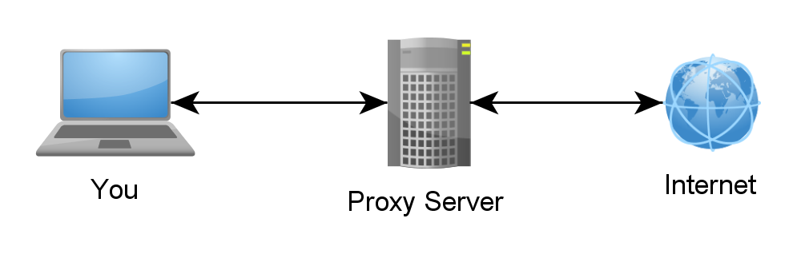
SSH Tunnels
SSH Tunnels are secure and encrypted between endpoints!
Local port forwarding
  Similar to port forwarding on a home router
  ssh –L source_port:destination_host:destination_port user@host.tld
    Ex: ssh -D 55555 -L 55110:csvm1.cs.edinboro.edu:5110 user@cslab100.cs.edinboro.edu
    This command opens an encrypted tunnel between my local machine and ssh server cslab100.cs.edinboro.edu
    Traffic sent to localhost port 55110 is redirected to csvm1.cs.edinboro.edu port 5110
    A dynamic SOCKS proxy is opened on port 55555
    You can do the same with a putty shortcut in Windows

Slide 51
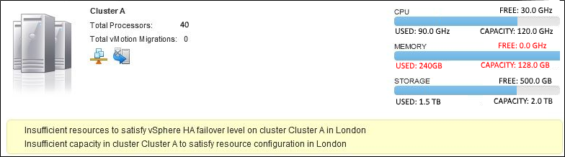
VM Server Considerations
Hypervisor server(s):
  2x10 core 3.0GHz CPU’s w/hyperthreading (40 vCPU’s)
  128GB RAM
  2.0TB Storage
15 guests
  2 vCPU each
  16GB RAM each
  100GB storage each
Guest Usage (hosts):
  30 vCPU (75% - 90/120GHz)
  240GB RAM! (187.5%)
  1.5TB Storage (75%)
Incorrect sizing specifications for the load! Memory should be increased, or CPU count should be decreased, on hypervisor.
Overcommitted RAM!

Slide 52
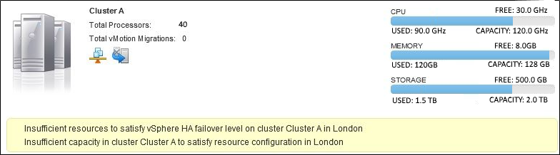
VM Server Considerations
Hypervisor server(s):
  2x10 core 3.0GHz CPU’s w/hyperthreading (40 vCPU’s)
  128GB RAM
  2.0TB Storage
15 guests
  2 vCPU each
  8GB RAM each
  100GB storage each
Guest Usage (hosts):
  30 vCPU (75% - 90/120GHz)
  120GB RAM (93.75%)
  1.5TB Storage (75%)
Better configuration, near maximum load!
Near Maximum Load
Notes:
*Picture not representative of numbers listed!

Slide 53
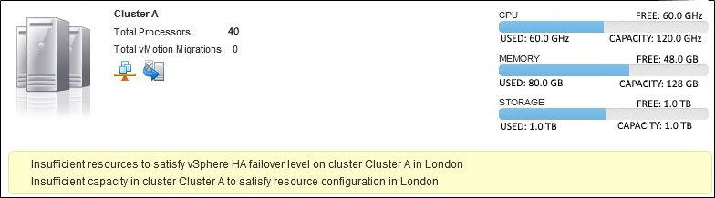
VM Server Considerations
Hypervisor server(s):
  2x10 core CPU’s w/hyperthreading (40 vCPU’s)
  128GB RAM
  2.0TB Storage
10 guests
  2 vCPU each
  8GB RAM each
  100GB storage each
Guest Usage (hosts):
  20 vCPU (50% - 60/120GHz)
  80GB RAM (62.5%)
  1.0TB Storage (50%)
Optimal configuration, allowing for good resource usage and failover availability
N+1!
Optimum Configuration!
Notes:
*Picture not representative of numbers listed!

Slide 54
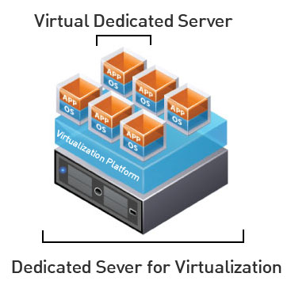
Virtual Machines
Emulates a computer system through specialized software
May provide virtualization of a full system or single process
Allows for greater use of resources
Increased flexibility
Hypervisors (hosts) and virtual machines (guests)
Hypervisor Examples
  Qemu
  VirtualBox
  VMWare
  Acropolis

Slide 55
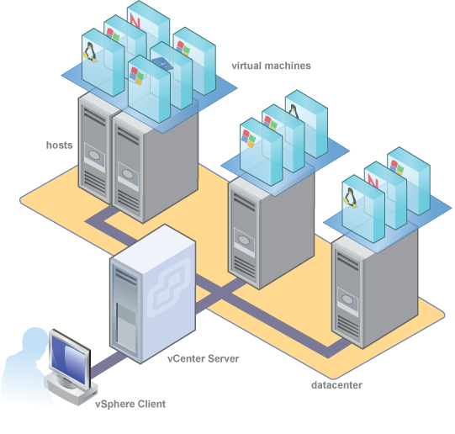
Virtual Machines
VM Clusters are comprised of multiple hypervisors (hosts)
Guests (virtual machines) run on hosts (hypervisors)
Hosts are grouped together to make a cluster
Clusters are controlled by a management server
Clients access the management server to
manipulate clusters, hosts, and guests
Guests can be of any compatible OS
Hosts must be of similar OS and hypervisor software
  Hyper-V, VMWare, KVM, etc.

Slide 56
VM Cluster Failover Capacity
Hypervisor Guest Usage (10 guests per host):
  20 vCPU (50%)
  80GB RAM (62.5%)
  1.0TB Storage (50%)
Cluster
  4 hosts (40vcpu, 128GB RAM, 2TB Storage)
  Each host running 10 guests at above spec
    80 vCPU Total (50%)
    320GB RAM Total (62.5%)
    4.0TB Storage (50%)
    40 Virtual Machines Total
If there is a failure of one hypervisor, all guests on that host must failover to other hosts in that cluster!
3 hosts running load to the right:
  2 hosts with 13 guests:
    26 vCPU (65%)
    104GB RAM (81.25%)
    1.3TB Storage (65%)
  1 host with 14 guests:
    28 vCPU (70%)
    112GB RAM (87.5%)
    1.4TB Storage (70%)
N+1 Redundancy!

Slide 57
Types of Servers
Application Server
  Host applications allowing users to run
Catalog Server
  Maintains index of information
Communications Server
  Maintains environment necessary for end to end communications
Compute Server
  Provides CPU and memory resources
Database Server
  Maintains and shares a database
File Server
  Shares files and folders over the network
Game Server
  Hosts game services allowing multiplayer connectivity
Hypervisor Server (Virtual Machine Host)
  Hosts virtual machines
Mail Server
  Processes email communications
Proxy Server
  Acts as an intermediary between a client and a server, redirecting traffic from a source to a target
Web Server
  Hosts web pages and associated necessary software

Slide 58
Server Administrators
A server administrator, or admin has the overall control of a server. This is usually in the context of a business organization, where a server administrator oversees the performance and condition of multiple servers in the business, or it can be in the context of a single person running a game server.
The Server Administrator's role is to design, install, administer, and optimize company servers and related components to achieve high performance of the various business functions supported by the servers as necessary. This includes ensuring the availability of client/server applications, configuring all new implementations, and developing processes and procedures for ongoing management of the server environment. Where applicable, the Server Administrator will assist in overseeing the physical security, integrity, and safety of the data center/server farm.
Wikipedia

Slide 59

Server Administrators
Provide access to software and services
  Software Installation
  General Troubleshooting
Provide a reliable and consistent environment
  Maintain consistency across environment
  Ensure proper design and connectivity, redundancy
Minimize the harm that users can do to the environment
  Elevate or restrict permissions as necessary
Manage specific server functionality
  Web, Database, DNS, etc.
Work with vendors and providers to build systems and create connections
System changes or upgrades

Slide 60
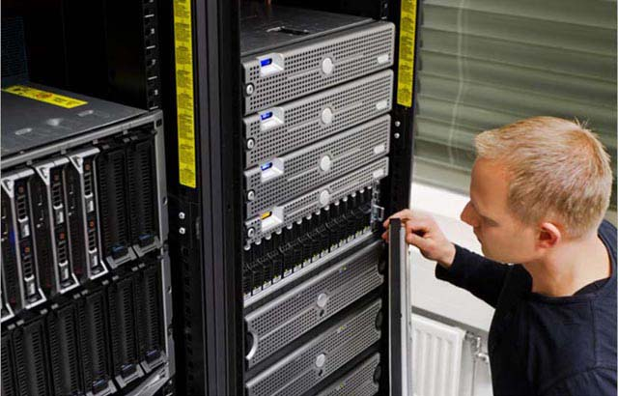
Server Administrators
Common Tasks
  Specifying, purchasing, and installing physical hardware
    Necessary levels of redundancy, storage, memory, wiring, etc.
  Managing device firmware levels, configuring integrated systems such as BIOS or firmware
  Configuring operating systems and server hardware
    Drive layouts and specifications
    Network or storage connection configurations
    Operating system configuration and maintenance
  Configure, maintain, and test Backups
    Disaster Recovery
  Maintain and monitor system security and integrity
  Interface with other business areas
  Documentation

Slide 61
Server Administrators
Database Administrator
  Maintains a database system and is responsible for the integrity of the data.
Network Administrator
  Maintains network infrastructure such as switches, routers, and various interconnecting devices.
Security Administrator
  Maintain security policies and administer security devices such as firewalls and security appliances.
Web Administrator
  Maintain services related to providing web site access and configuration.
OS Administrator
  Maintain operating system installation and upkeep, including hardware, patching, and system consistency.
Storage Administrator
  Maintain a storage infrastructure and connected devices, such as a SAN or NAS.

Slide 62
Network Addresses
A unique identifier for a node or interface on a communications network
  Addresses may be unique throughout the entire world (public IP space)
  Addresses may only be unique throughout specific network segment (private network space)
Multiple network addresses can be configured on a single network
  Virtual IP Addresses (VIPs) – Often used in a clustered environment
Examples:
  IPv4 addresses: 147.64.242.100
  IPv6 addresses: 2607:f8b0:4004:806::200e
  MAC Address: 00:23:7D:FC:49:8C
  Telephone Number: 1-814-732-2000

Slide 63
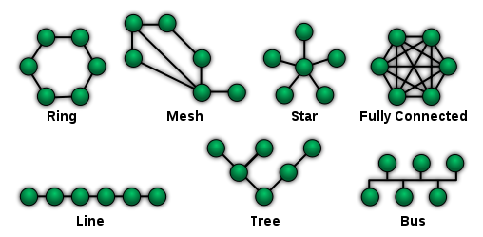
Network Topologies
Point-to-Point
  Direct link between two endpoints
  Switched topologies in telephony
  Easy, simple, minimal cost
Bus
  Nodes connected to common liner link
  Collision control
  Easy, lower cost
  Large fault domain, difficult to identify cable problems
Star
  Most common topology
  Central connection to each node
  Multiple fault domains
  More expensive to implement

Slide 64
Network Topologies
Ring
  Each computer connects to another, forming a closed loop
  Easier to identify and isolate faults
  One malfunctioning device can create problems
  Difficult to add or reconfigure nodes
Mesh
  Fully connected or partially connected
  Can use flooding or routing technique
  Usually most expensive

Slide 65
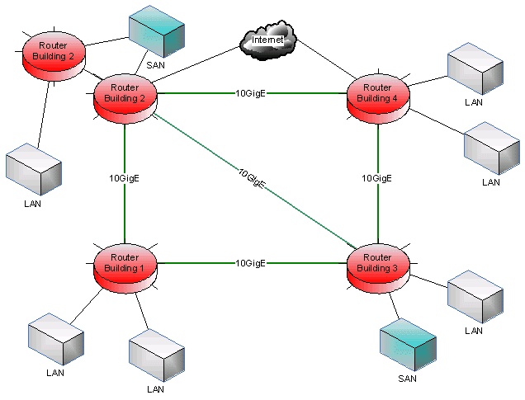
Network Topologies
LAN
  Local Area Network
  Connects devices within a limited area, such as a home or school
  Coax, twisted pair, fiber
  Switch Ethernet network is most common
MAN
  Municipal Area Network
  Computer network that is larger than a LAN, spanning multiple city blocks or an entire city
  ATM, FDDI

Slide 66
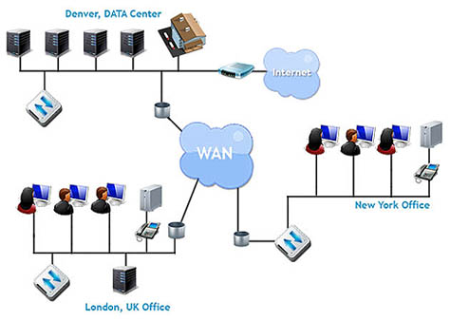
Network Topologies
WAN
  Networking technologies used to transmit data over long distances, and between different LANs, MANs and other localized computer networking architectures.
  Internet can be considered a type of WAN
  Often used to connect multiple data centers
  Can provide for replication across long distances
NAT a specific set of private IP addresses behind a unique public IP address!

Slide 67
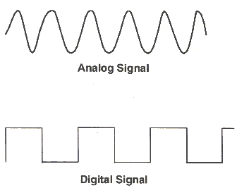
Data Transmission
Data is transmitted as electrical waves or pulses of light
Data is transmitted as ones or zeros
Analog signals consist of waves
Digital signals consist of on/off states
These waves or on/off signals represent ones and zeros
Ones and zeros are reconstructed to create information
The frequency of transmission is measured
in Hertz (cycles per second)

Slide 68

Data
Pieces of information
Represented as bits (0 or 1) on a medium
8 bits make a byte
1 byte can represent up to 256 unique values
Bit 7 | Bit 6 | Bit 5 | Bit 4 | Bit 3 | Bit 2 | Bit 1 | Bit 0
2⁷ | 2⁶ | 2⁵ | 2⁴ | 2³ | 2² | 2¹ | 2⁰
128 | 64 | 32 | 16 | 8 | 4 | 2 | 1

Slide 69
Data
Bit 7 | Bit 6 | Bit 5 | Bit 4 | Bit 3 | Bit 2 | Bit 1 | Bit 0
2⁷ | 2⁶ | 2⁵ | 2⁴ | 2³ | 2² | 2¹ | 2⁰
128 | 64 | 32 | 16 | 8 | 4 | 2 | 1
1 | 0 | 1 | 1 | 0 | 0 | 0 | 1
128 | 0 | 32 | 16 | 0 | 0 | 0 | 1
Binary Value: 10110001
Decimal Value: 128+32+16+1
Final Value: 177

Slide 70
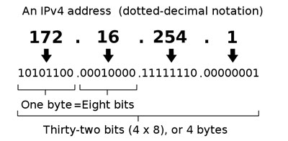
IP Addresses
IPv4 – Dotted decimal notation
  192.168.0.1/24
  2^32 addresses (4,294,967,296)
  Four 8-bit integers
  Private ranges
    10.0.0.0/8
      10.0.0.0-10.255.255.255
    172.16.0.0/12
      172.16.0.0-172.31.255.255
    192.168.0.0/16
      192.168.0.0-192.168.255.255

Slide 71
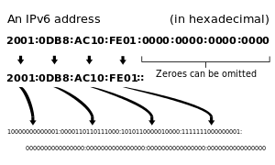
IP Addresses
IPv6 – Hexadecimal notation
  2001:0000:0000:0000:0000:7a11:a1e:cafe/32 (2001::7a11:a1e:cafe/32)
  2^128 addresses (340,282,366,920,938,463,463,374,607,431,768,211,456)
  Eight groups of four hexadecimal digits
  Values between 0-F

Slide 72
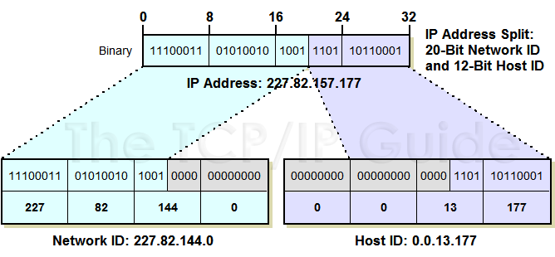
IP Addresses
IPv4 – Dotted decimal notation

Slide 73
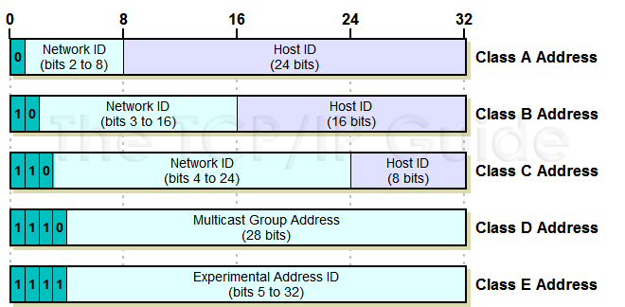
IP Addresses - Classful
IPv4 – Dotted decimal notation

Slide 74

IP Addresses - Classless
Classless Inter-Domain Routing (CIDR)
  Based on variable length subnet masking (VLSM)
  Allows a network to be divided in to variously sized subnets
  Introduced CIDR notation
    Network ID followed by hostmask
    192.168.0.0/24
  Provides for subnetting
    Create subnets within larger address block
  Reduces routing table entries
    Multiple consecutive route entries can be combined into “supernets”
  CIDR Calculator
    http://www.subnet-calculator.com/cidr.php

Slide 75
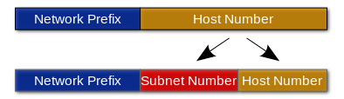
Subnetting
A subnet is an identifiably separate part of an organizations network.
Created by dividing the host identifier into an additional network identifier.
Subnets will have their own routing and broadcast addresses.

Slide 76
Subnetting
Subnet masks perform a bitwise AND operation to any IP address to find the routing prefix.
Subnet masks are often written in dot-decimal notation or CIDR notation
  IP: 192.168.5.130 - Hostmask: 255.255.255.0
  CIDR: 192.168.5.130/24
 | Binary Form | Dot-decimal notation
IP address | 11000000.10101000.00000101.10000010 | 192.168.5.130
Subnet mask | 11111111.11111111.11111111.00000000 | 255.255.255.0
Network prefix | 11000000.10101000.00000101.00000000 | 192.168.5.0
Host part | 00000000.00000000.00000000.10000010 | 0.0.0.130

Slide 77
Private Networks
A private network is a network which uses private IP addresses for devices
  10.0.0.0/8
    10.0.0.0-10.255.255.255
  172.16.0.0/12
    172.16.0.0-172.31.255.255
  192.168.0.0/16
    192.168.0.0-192.168.255.255

Slide 78
Private Network Subnet Example
172.16.0.0/12
  10101100.0001NNNN.NNNNNNNN.NNNNNNNN
10101100.00010000.00000000.00000000
  172.16.0.0
10101100.00011111.11111111.11111111
  172.31.255.255
Effective IP range:
  172.16.0.0-172.31.255.255
Subnet Calculator
  http://www.subnet-calculator.com/cidr.php

Slide 79
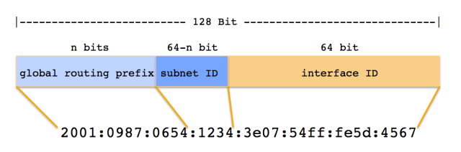
IP Addresses
IPv6 – Hexadecimal notation
Base 16 (hex)
128 bit address (2^128)
IPv4 – Dotted Quad Notation
Base 2 (binary)
32 bit address (2^32)
IPv6!

Slide 80
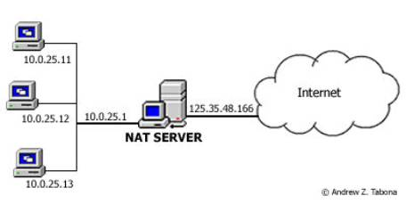
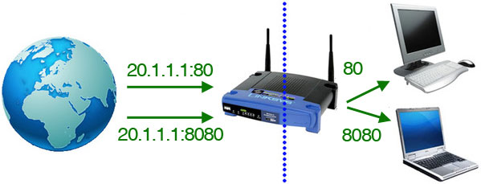
Private Networks
Private networks use Network Address Translation (NAT) to provide unique private IP address to devices, allowing all devices to share the same public IP address.
Connections are mapped to individual ports for maintaining communication between NAT’d clients and internet services by the NAT device.
Nat increases the lifespan of the IPv4 address space, by allowing multiple clients to share a single public IP address.

Slide 81
Domain Names
A domain name is an identification string that defines a resource and the controlling authority within the internet.
Domain names are formed by the rules of the Domain Name System (DNS).
Domain names are used to represent IP addresses, creating an easier method of describing information without the need to remember exact IP addresses.
Domain names are registered with Domain Name Registrars, who are allowed to modify the related information in the central registry database.
The main purpose of domain names is to identify Internet resources, without the need to remember actual numerical addresses.
A Fully Qualified Domain Name (FQDN) represents a specific item in the DNS hierarchy.
  Ex: cslab100.cs.edinboro.edu

Slide 82
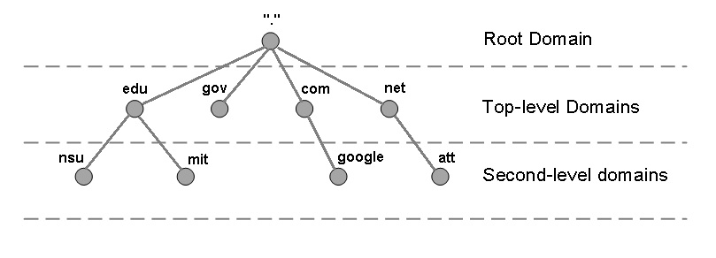
Domain Name System (DNS)
A hierarchical distributed naming system for any resource connected to the Internet or a private network.
Associates various information with domain names
Translates domain names into IP addresses and IP addresses into domain names
Top servers in DNS hierarchy are called root name servers
Notes:
IP addresses are analogous to telephone numbers
DNS Servers maintain the telephone directory

Slide 83
DNS Record Types
Type Description Function
A Address Record 32-bit IPv4
AAAA IPv6 Address Record 128-bit IPv6
CNAME Canonical Name Alias; Nickname
MX Mail Exchange Mail Server
NS Name Server DNS Records
PTR Pointer Record Reverse DNS
SOA Start of Authority Authoritative Info
TXT Text Record Various (mail, pub encryption key, etc)
SPF Sender Policy Framework E-Mail validation information
Notes:
Many more types of records available

Slide 84
A, AAAA, MX, CNAME and TXT Records
edinboro.edu. A 147.64.32.245
edinboro.edu. A 147.64.32.6
edinboro.edu. AAAA 2002:9340:2006::9340:2006
edinboro.edu. AAAA 2002:9340:20f5::9340:20f5
chemstock CNAME chemstock-p.cs.edinboro.edu.
edinboro.edu. MX 5 spamblock.edinboro.edu.
edinboro.edu. TXT "v=spf1 ip4:147.64.32.99/32 ip4:147.64.32.120/32 ip4:147.64.32.121/32 ip4:147.64.32.205 ip4:147.64.32.206 ~all"
scots TXT "v=spf1 include:exchangelabs.com ~all"
Notes:
Trailing period completes domain
Records without trailing period append domain name
MX records indicate mail server priority
TXT records shows SPF record; SPF in TXT has been deprecated, SPF has its own record type

Slide 85
Start of Authority Record (SOA)
eupcs.org IN SOA ns1.eupcs.org. jpatalon.edinboro.edu. (
2011111105 ; serial
21600 ; refresh (6 hours)
600 ; retry (10 minutes)
1209600 ; expire (2 weeks)
10800 ; minimum (3 hours)
)
Notes:
RFC 1035 Defines SOA
RFC 1912 specifies serial in format YYYYMMDDnn

Slide 86
Start of Authority Record (SOA)
Primary Name Server for the domain
Responsible party
  At sign (@) is replaced with a period
Serial Number
  Version of domain file
Refresh
  How often slave tries to refresh zone from master.
Retry
  How long slave should wait to refresh zone from master if the refresh failed.
Expire
  Amount of time until slave server can no longer be considered authoritative for zone.
Minimum (negative caching time)
  How long an error on a record can be kept before another lookup must be performed.
Notes:
RFC 1912 specifies refresh, retry, expire
RFC 2308 specifies minimum

Slide 87
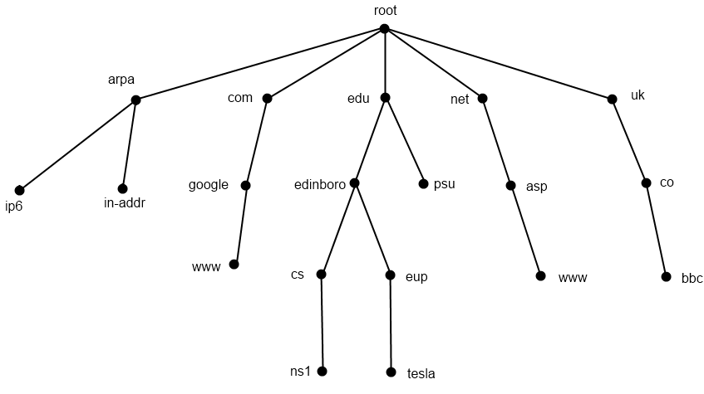
Hierarchical View
Notes:
13 Root nameservers maintainers, such as verisign, nasa & U of Maryland
259 total root servers (as of 11/30/11)
273 TLD’s
63 characters per level
127 levels max
253 characters per FQDN

Slide 88
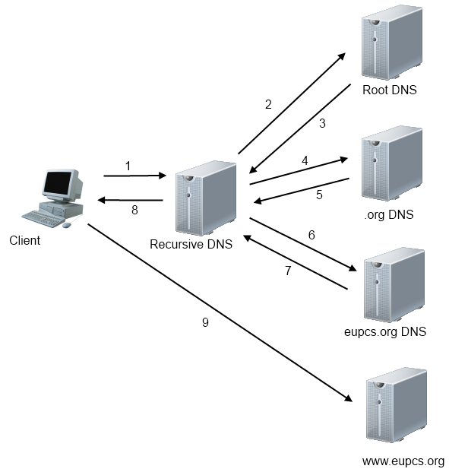
DNS Transaction
Recursive
Cached

Slide 89
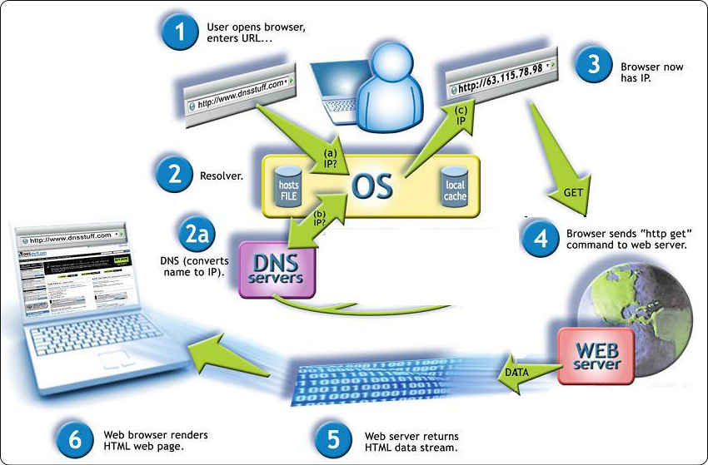
Webpage Resolution
User enters URL in web browser
OS Looks up IP address
  If locally cached, return cached content
Lookup request to DNS server
Response received from DNS server
OS returns IP address to web browser
Web browser queries IP address for content
Content is returned to web browser and rendered as a web page

Slide 90
Whois Records
More detailed information specifically about the domain
whois eupcs.org
  Registrant ID:CR36875534
  Registrant Name:Jason Patalon
  Registrant Organization:Edinboro University Computer Science Club
  Registrant Street1:Doucette Hall Room 200
  Registrant Street2:215 Meadville St.
  Registrant Street3:
  Registrant City:Edinboro
  Registrant State/Province:Pennsylvania
  Registrant Postal Code:16444
  Registrant Country:US
  Registrant Phone:+1.8147322000
  Registrant Phone Ext.:
  Registrant FAX:
  Registrant FAX Ext.:
  Registrant Email:jpatalon@edinboro.edu

Slide 91
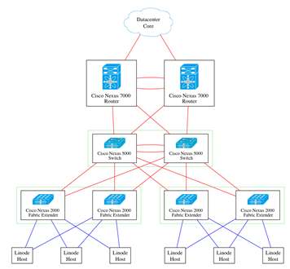
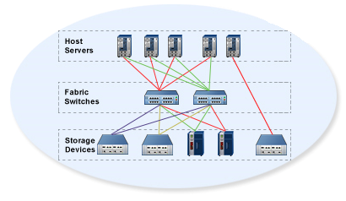
Server Connections
Ethernet Network
  Multiple interfaces provide redundancy
  Active/Backup or Active/Active
  1-10+ GBps
Storage Area Network
  Separate physical network
  Redundancy
  Connection between server and disk
  4-8+ GBps

Slide 92
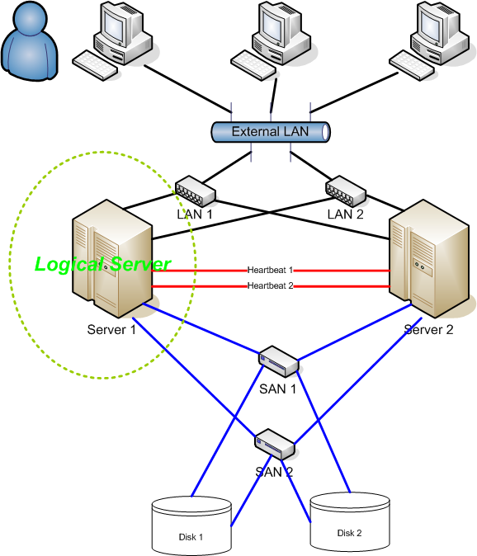
High Availability
High Availability (HA) refers to the availability of resources in a computer system, in the wake of component failures in the system.
HA is a characteristic of a system
HA Systems feature several key items:
  Elimination of single points of failure
  Reliable components
  Failure detection
HA is generally measured by unscheduled downtime
Fault Domain

Slide 93
High Availability
HA is measured by downtime
  Scheduled downtime
    System patches or configuration changes requiring a reboot
    Logical, scheduled, approved events
  Unscheduled downtime
    Internal or external hardware or software failure
    Natural disaster, security breach
Availability is usually measured as a percentage
  Percentage of minutes per year a system is online
  99.999% - Five Nines – 5.26 minutes (5:16) of downtime per year
May be measured and interpreted multiple ways

Slide 94

Connecting to our VM’s
New method of connecting to CS Network
Connect to VPN
  Windows Thick Client
  Windows L2TP
  MacOS L2TP
  Chromebook/Linux L2TP?
    Untested…
EUP-CS VPN
  Remote host: 147.64.2.12 (vpn.cs.edinboro.edu or vpn.ultrastuff.net)
  Pre-Shared Key: <credentials.txt>
  Username and password for students
    VPN Username: <credentials.txt>
    VPN Password: <credentials.txt>
Creds in credentials.txt

Slide 95
Create a VPN Connection – Windows Client
Windows – Sonicwall VPN Client
  Download and install the client
    https://software.sonicwall.com/GlobalVPNClient/184-011921-00_REV_A_GVCSetup64.exe
  Give the connection a name: EUP-CS VPN
  Remote host: 147.64.2.12 (vpn.cs.edinboro.edu or vpn.ultrastuff.net)
  Pre-Shared Key: <credentials.txt>
  Username and password for students
    VPN Username: <credentials.txt>
    VPN Password: <credentials.txt>
  Enable the connection!
Creds in credentials.txt

Slide 96
Create a VPN Connection – Windows L2TP
Windows – Layer 2 Tunneling Protocol (L2TP/IPsec)
  Start → Settings → Network & Internet → VPN
    Add VPN
  Give it a name: EUP-CS VPN
  Server address: 147.64.2.12 (vpn.cs.edinboro.edu or vpn.ultrastuff.net)
  VPN Type: L2TP/IPSec with pre-shared key
  Pre-Shared Key: <credentials.txt>
  Username and password for students
    VPN Username: <credentials.txt>
    VPN Password: <credentials.txt>
  Connect on the VPN network!
  You may need to enable the option to tunnel all traffic through the VPN…
Creds in credentials.txt

Slide 97
Create a VPN Connection – MacOS L2TP
Mac OS – Layer 2 Tunneling Protocol (L2TP/IPsec)
  System Preferences → Network
    Three dots in lower right corner → Add VPN Config → L2TP over IPSec
  Give it a name: EUP-CS VPN
  Server address: 147.64.2.12 (vpn.cs.edinboro.edu or vpn.ultrastuff.net
  Pre-Shared Key: <credentials.txt>
  Username and password for students
    VPN Username: <credentials.txt>
    VPN Password: <credentials.txt>
  Connect on the VPN network!
  You may need to enable the option to tunnel all traffic through the VPN…
Creds in credentials.txt

Slide 98
Create a VPN Connection – Chromebook L2TP/IPsec
Chromebook – Layer 2 Tunneling Protocol (L2TP/IPsec)
  Settings→ Network
  Add built-in VPN → Add connection
  Give it a name: EUP-CS VPN
  Authentication type: Pre-shared key
  Server hostname: 147.64.2.12 (vpn.cs.edinboro.edu or vpn.ultrastuff.net)
  Pre-Shared Key: <credentials.txt>
  Username and password for students
    VPN Username: <credentials.txt>
    VPN Password: <credentials.txt>
  Connect on the VPN network!
  You may need to enable the option to tunnel all traffic through the VPN…
  https://support.google.com/chromebook/answer/1282338?hl=en#zippy=%2Cltpipsec-vpn-support
Creds in credentials.txt

Slide 99
Connect to CS VPN with a SSH Connection
Open a command prompt terminal
    In Windows, a cmd shell or powershell
    In Linux, your default command line shell
  SSH to the server jpatalon.cs.edinboro.edu on port 54321
    You will need to use the format of username@jpatalon.cs.edinboro.edu to specify the
    correct username when connecting!
    The username and password are contained in the credentials file within D2L
  Forward ports for SOCKS and VNC connections!
    SOCKS port 555##
    VNC port 559##
      Replace ## with your 2 digit number!
  Example SSH connection command:
    ssh -p 54321 cs_student@jpatalon.cs.edinboro.edu -D 555## -L 559##:147.64.242.113:559##
Creds in credentials.txt

Slide 100
Connecting to our VM’s
IP Address: 147.64.243.1## (01-25)
  Use your two digit number from below!
Default root password: <credentials.txt>
Two digit number:
  Tanner A: 01
  Osaretin I: 02
  Derek J: 03
  Benjamin K: 04
  Tanner P: 05
  Dennis V: 06
  Louie Y: 07
  Professor J: 08 & 09 & 10
Aliases will be used in the future…

Slide 101

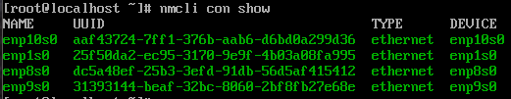
Assignment 2
Log in to your VM’s OOB console using Virtual Network Computing (VNC)
  VNC OOB: csvm1.cs.edinboro.edu:559## (01-25)
    If using SSH connection, you must forward the correct port and connect with VNC to localhost:599## !!!
  Either connect to the CS VPN, or open an SSH tunnel to forward the proper port!
    ssh -p 54321 cs_student@jpatalon.cs.edinboro.edu -D 555## -L 559##:147.64.242.113:559##
      Connect to localhost port 559## via VNC! (RealVNC Viewer?)
      Login creds are in credentials.txt file!
Set up your network connection
  View network connections with nmcli con show
  We want to configure device enp1s0!

Slide 102
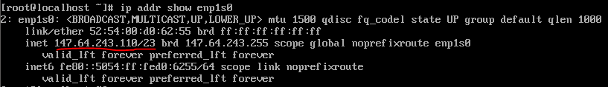
Assignment 2
Set up your network connection
  We want to configure device enp1s0!
    nmcli con down enp1s0
    nmcli con mod enp1s0 ipv4.method manual ipv4.addresses 147.64.243.1##/23
    nmcli con mod enp1s0 ipv4.gateway 147.64.242.1
    nmcli con mod enp1s0 ipv4.dns "8.8.8.8,8.8.4.4"
    nmcli con up enp1s0
    ip addr show enp1s0

Slide 103
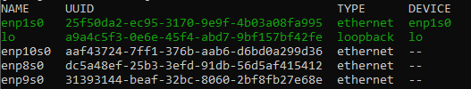
Assignment 2
Set up your network connection
  Disable all the other interfaces:
    nmcli con mod enp8s0 connection.autoconnect no
    nmcli con down enp8s0
    nmcli con mod enp9s0 connection.autoconnect no
    nmcli con down enp9s0
    nmcli con mod enp10s0 connection.autoconnect no
    nmcli con down enp10s0
    nmcli con show

Slide 104
Assignment 2
Change the root password!
  Make sure you don’t forget it!
  passwd root
Set the local machine hostname!
  hostnamectl set-hostname cmac3990-1##.cs.edinboro.edu
Update your system
  dnf update
Install some additional software with dnf
  dnf install bind-utils nano net-tools sendmail s-nail wget
Create SSH key as root (accept all defaults!)
  ssh-keygen

Slide 105
Assignment 2
Import professors public SSH key into your root accounts authorized_keys file
  curl https://jpatalon.cs.edinboro.edu/cmac3990/classfiles/root@cmac3990-110.pubkey >> /root/.ssh/authorized_keys
  Make sure permissions on authorized_keys file is correct!
    chmod 600 /root/.ssh/authorized_keys
Add user account named “user” and a user account for yourself
  useradd user
  useradd accountname
Set the passwords for the user account and your new account
  passwd user
  passwd accountname
Start and enable sendmail for assignment submissions!
  systemctl enable --now

Slide 106
Assignment 2
Give your user account sudo
  Create a new file for this at /etc/sudoers.d/users
    accountname ALL=(ALL) ALL
Disable SSH root password login
  Only allow root user SSH key based login
    Edit the /etc/ssh/sshd_config file and uncomment the line:
      PermitRootLogin prohibit-password
Update and reboot your system
  dnf update
  reboot
Validate you can still log in after rebooting!
  You must log in as your new accountname instead of root!
Run professor’s check script!
  https://jpatalon.cs.edinboro.edu/cmac3990/classfiles/assignment2check.sh
  Due Friday September 5th, 2025
    Submit by the end of the day!
Don’t forget the documentation!

Slide 107

Key Terms
Host (Hypervisor)
Guest (Virtual Machine)
RFC
DNS
Servers & types
Administrators
IPv4, IPv6
LAN, MAN, WAN
SAN vs NAS vs DAS
Subnet
High Availability
Environments
Fault Domain
Clusters

Slide 108

For Next Week
“The quieter you become, the more you can hear.” –Ram Dass
Homework Assignment 1 – Due Wednesday September 3rd, 2025
Homework Assignment 2 – Due Friday September 5th, 2025
Textbook Reading
  Chapter 1: Where to Start
  Chapter 2: Booting & Daemons
  Chapter 3: Access Control & Root
Starting work with VM’s
  VPN / Multiple SSH Hops
  SOCKS 5 Proxy Tunnel for webpages?!
  VM Configurations!
Directory Services

